Slide 1
ECM
Extending Children's Mathematics
GANAG lesson
ECM
Extending Children’s Mathematics
GANAG Lesson
Dr. Cindy Viala
Third grade
March of 2013

Slide 2
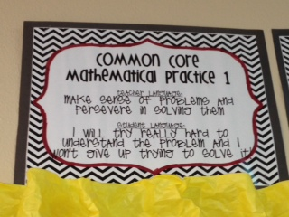
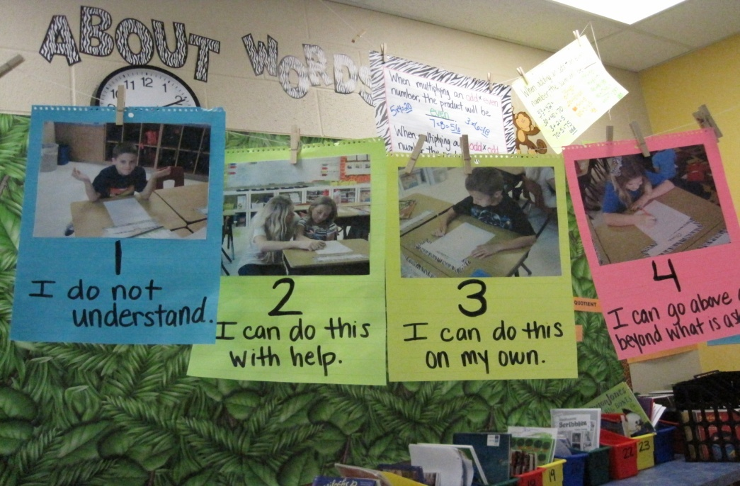
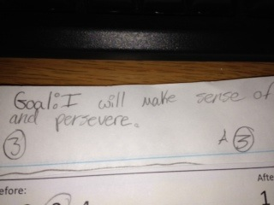
Goal
Goal : Make sense of problems and persevere in solving them. (Mathematical Practice 3.MP.1)
Students score themselves on the goal (1, 2, 3,or 4)

Slide 3
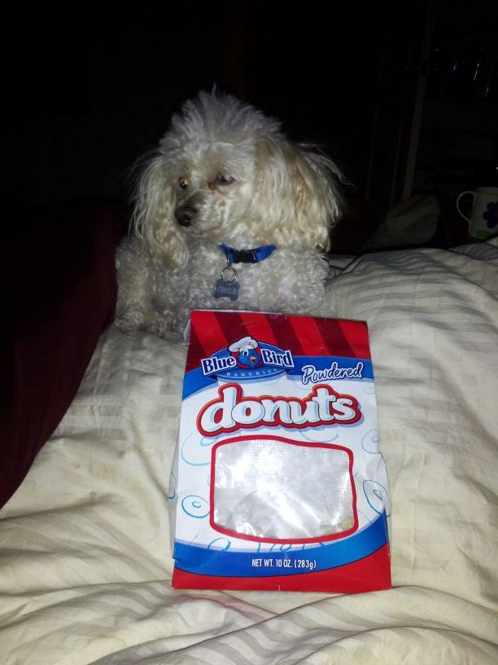
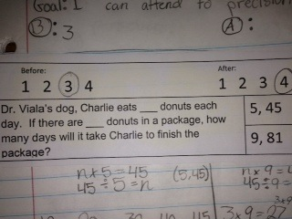
Access Prior Knowledge
Display picture to get
the students “hooked.”
Read problem with students and discuss with students what they know about the problem and what they are trying to find out.

Slide 4
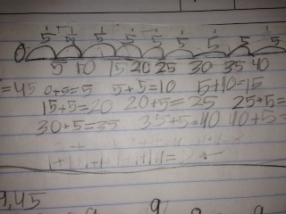
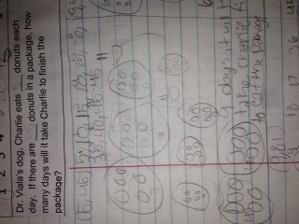
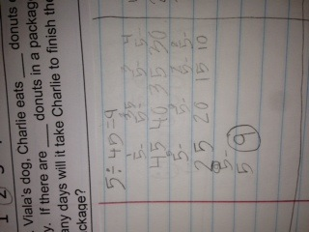
New Information
After students have worked the problem, students gather at the carpet area to discuss strategies. The teacher has purposefully chosen certain student strategies.
Direct Modeling
Repeated Addition
Repeated Subtraction

Slide 5
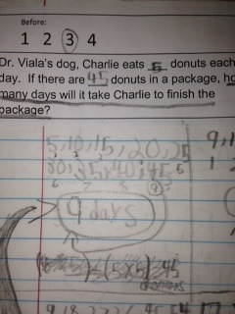
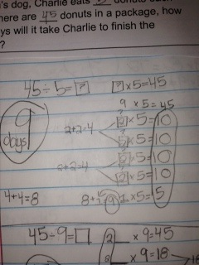
New Information
High Yield Strategy
(2) Identifying Similarities and Differences
Students compared and contrasted each other’s strategies. They looked at the notation and were asked how they could notate more efficiently.
Relational Thinking
Skip Counting

Slide 6
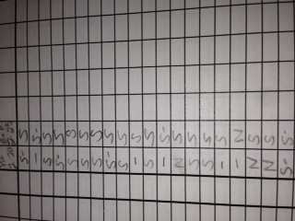
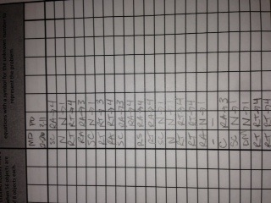
Scoring to the Standards
While students were working the teacher walked around with her scoring guide and scored to the standard:
3.OA.5 Apply properties of operations as strategies to multiply and divide.
3.OA.7 Fluently multiply and divide within 100, using strategies such as the relationship between multiplication and division or properties of operation.

Slide 7
Application
After discussion, students were given one more number set to apply new strategies.
Goal
At the end of the lesson the goal is re-visited and students score themselves.

